Slide 1
Introduction to Coding Workshop
Here is where your presentation begins

Slide 2
Contents of this template
You can delete this slide when you’re done editing the presentation
Fonts | To view this template correctly in PowerPoint, download and install the fonts we used
Used and alternative resources | An assortment of graphic resources that are suitable for use in this presentation
Thanks slide | You must keep it so that proper credits for our design are given
Colors | All the colors used in this presentation
Icons and infographic resources | These can be used in the template, and their size and color can be edited
Editable presentation theme | You can edit the master slides easily. For more info, click here
For more info:
Slidesgo | Blog | FAQs
You can visit our sister projects:
Freepik | Flaticon | Storyset | Wepik | Videvo

Slide 3
Table of contents
01
02
03
04
Theory lesson
Features of the topic
You can describe the topic of the section here
You can describe the topic of the section here
Tips
Practical exercise
You can describe the topic of the section here
You can describe the topic of the section here

Slide 4

01
Theory lesson
You can enter a subtitle here if you need it

Slide 5
Introduction
Mercury is the closest planet to the Sun and the smallest one in the entire Solar System. This planet’s name has nothing to do with the liquid metal, since Mercury was named after the Roman messenger god. Mercury’s surface is filled with craters
Mercury takes a little more than 58 days to complete its rotation, so try to imagine how long days must be there! Since the temperatures are so extreme, albeit not as extreme as on Venus, Mercury has been deemed to be non-habitable for humans

Slide 6

—Someone Famous
“This is a quote, words full of wisdom that someone important said and can make the reader get inspired”

Slide 7
Concepts
Mercury
Venus
Mercury is the closest planet to the Sun and the smallest one in the Solar System—it’s only a bit larger than the Moon
Venus has a beautiful name and is the second planet from the Sun. It’s hot and has a poisonous atmosphere

Slide 8
What is this topic about?
Mercury
Venus
Mars
It’s the closest planet to the Sun and the smallest in the Solar System
Venus has a beautiful name and is the second planet from the Sun
Despite being red, Mars is actually a cold place. It’s full of iron oxide dust

Slide 9
Features of the topic
Mars
Neptune
Despite being red, Mars is very cold
It’s the farthest planet from the Sun
Jupiter
Saturn
Jupiter is the biggest planet of them all
Saturn is a gas giant and has several rings

Slide 10

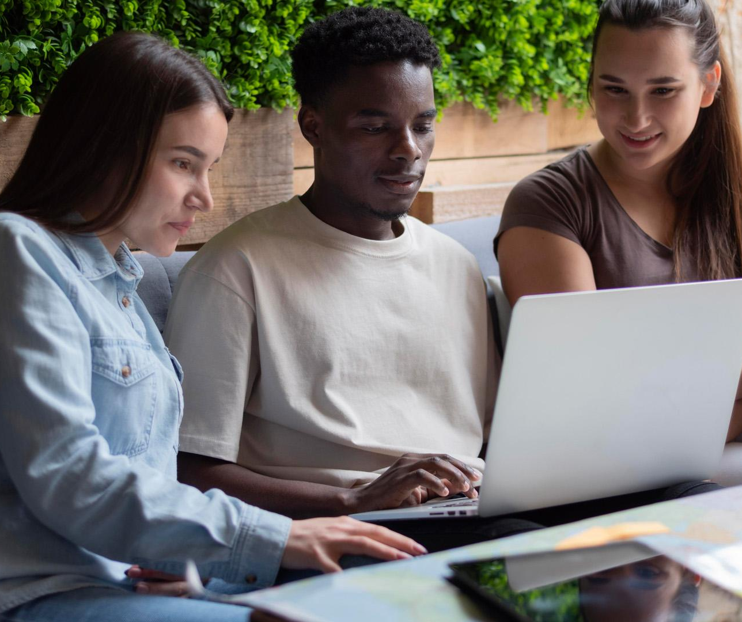
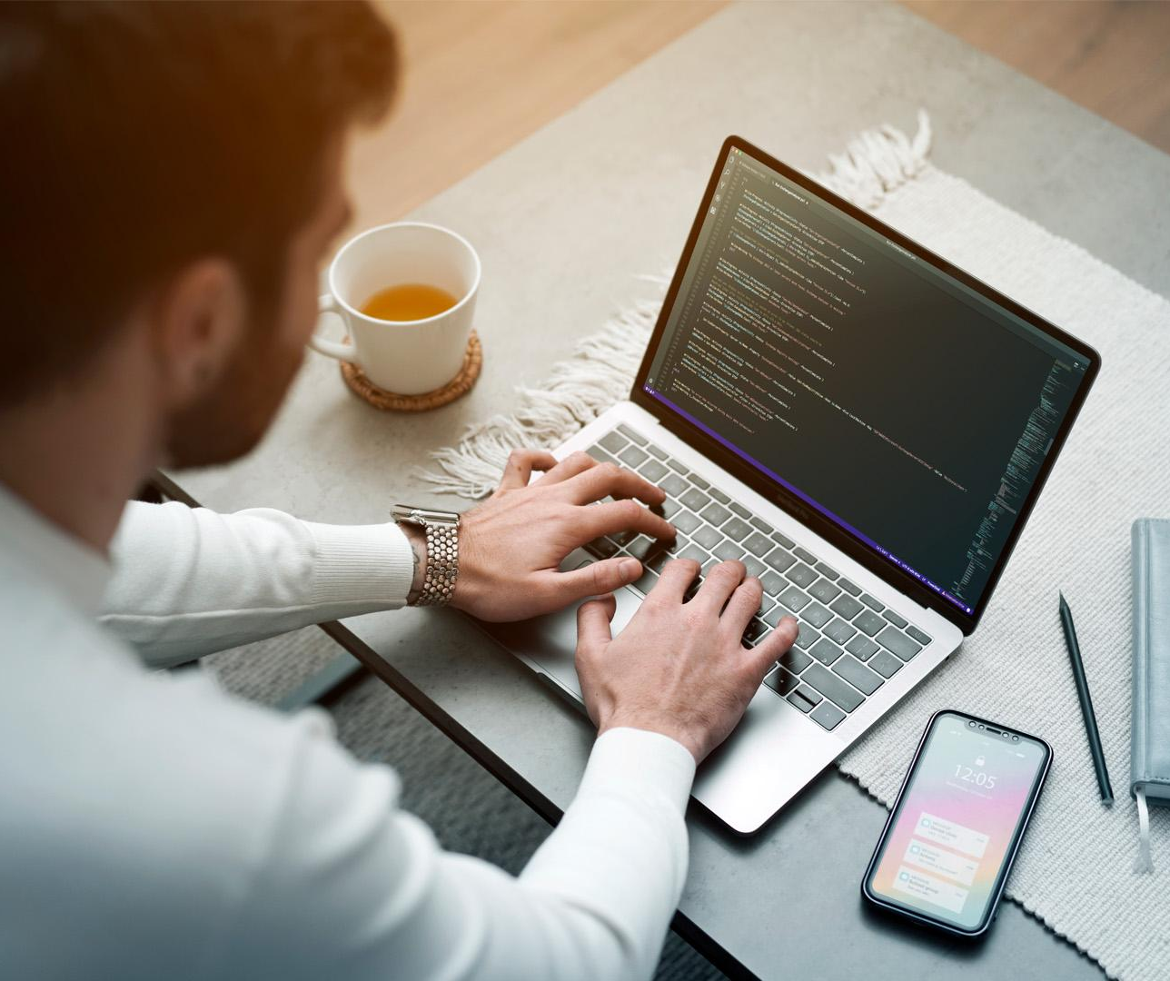
Examples
Mercury
Venus
Mars
It’s the closest planet to the Sun and the smallest in the Solar System
Venus has a beautiful name and is the second planet from the Sun
Despite being red, Mars is actually a cold place. It’s full of iron oxide dust

Slide 11
Recommendations
Mars
Venus
Neptune
Despite being red, Mars is very cold
Venus is the second planet from the Sun
Neptune is the farthest planet from the Sun
Mercury
Saturn
Jupiter
Mercury is the closest planet to the Sun
Saturn is a gas giant and has several rings
Jupiter is the biggest planet of them all

Slide 12

Image always reinforce
the concept
You can give a brief description of the topic you want to talk about here. For example, if you want to talk about Mercury, you can say that it’s the smallest planet in the entire Solar System

Slide 13
4,498,300,000
Big numbers catch your audience’s attention

Slide 14
9h 55m 23s
333,000
386,000 km
Jupiter’s rotation period
The Sun’s mass compared to Earth’s
Distance between the Earth and the Moon

Slide 15
Awesome words

Slide 16

A picture is worth a thousand words

Slide 17
Practical exercise - calculator
Objective:
Introduce participants to basic coding concepts by building a simple calculator
Instructions:
Open a Python development environment and write the following code:
# Simple Calculator
num1 = int(input("Enter the first number: "))
num2 = int(input("Enter the second number: "))
print("Sum:", num1 + num2)
print("Difference:", num1 - num2)
print("Product:", num1 * num2)
print("Quotient:", num1 / num2)
Run the program and experiment with different numbers
Observe the output

Slide 18
Brainstorm and idea generation
Mercury
It’s the smallest planet of them all
Earth
Venus
Venus is the second planet from the Sun
Power 1
Neptune
It’s the farthest planet from the Sun
Mars
Saturn
Saturn was named after a Roman god

Slide 19
Main topic and details
Mars
Neptune
Despite being red, Mars is very cold
It’s the farthest planet from the Sun
Jupiter
Saturn
Jupiter is the biggest planet of them all
It’s a gas giant and has several rings

Slide 20
Popular programming languages
01
Neptune
Mercury is the closest planet to the Sun and the smallest of them all
02
Venus
Venus has a beautiful name and is the second planet from the Sun
03
Earth
Earth is the third planet from the Sun and the only one that harbors life in the Solar System
04
Saturn
Saturn is a gas giant and has several rings. It’s composed mostly of hydrogen and helium

Slide 21
Sequences
Saturn is composed of hydrogen and helium
Mercury is the closest planet to the Sun
Jupiter was named after a Roman god
First
Next
Next
Next
Next
Last
Despite being red, Mars is very cold
Earth is the third planet from the Sun
Venus has extremely high temperatures

Slide 22
Classification
Mars | Venus | Mercury | Jupiter
Small Red Cold Rocky | Small Hot Dry Volcanic | Small Hot Rocky Cratered | Large Cold Gassy Striped
Mars is full of iron oxide dust | Venus has high temperatures | Mercury is quite a small planet | Jupiter is a huge gas giant

Slide 23
Cause and effect
Mars
Venus
Problem
Despite being red, Mars is very cold
Venus is the second planet from the Sun
Mercury
Saturn
Solution
Mercury is the closest planet to the Sun
Saturn is a gas giant and has several rings

Slide 24
Question and answer
Question
Is Mercury the closest planet to the Sun and the smallest one in the Solar System? Note that it’s a bit larger than the Moon
Answer
Venus has a beautiful name and is the second planet from the Sun. It’s hot and has a poisonous atmosphere

Slide 25
Step-by-step coding
01
02
03
04
Earth
Mercury
Jupiter
Saturn
It’s the only planet known to harbor life
Mercury is the closest planet to the Sun
Jupiter is the biggest planet of them all
Saturn was named after a Roman god

Slide 26
Parts and whole
The whole objective
Parts of the object
What happens if the parts are missing?
Mercury is the closest planet to the Sun and the smallest one in the entire Solar System
Mercury
Jupiter
Venus
Mars
Earth
Saturn
Mercury
Earth is the third planet from the Sun and the only one that harbors life in the Solar System
What’s the function of the parts?
Jupiter is a gas giant and the biggest planet in the Solar System

Slide 27
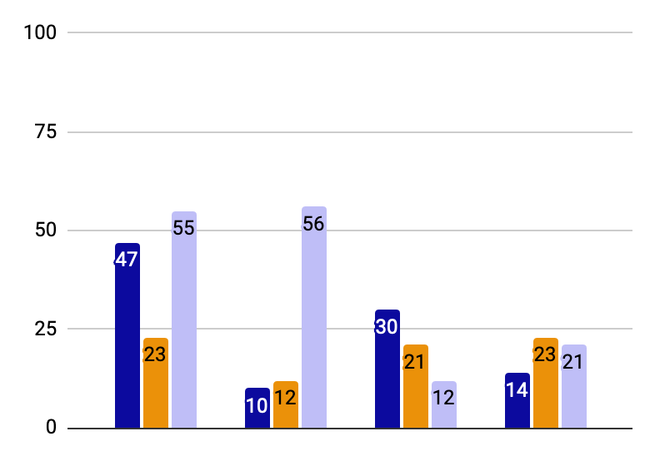
You can use this graph
Mercury
Mercury is the closest planet to the Sun
Jupiter
Jupiter is the biggest planet of them all
Saturn
Saturn was named after a Roman god
Follow the link in the graph to modify its data and then paste the new one here. For more info, click here

Slide 28
This is a map
USA
Russia
Despite being red, Mars is very cold
Neptune is the farthest planet from the Sun
India
China
Jupiter is the biggest planet of them all
Saturn is a gas giant and has several rings

Slide 29
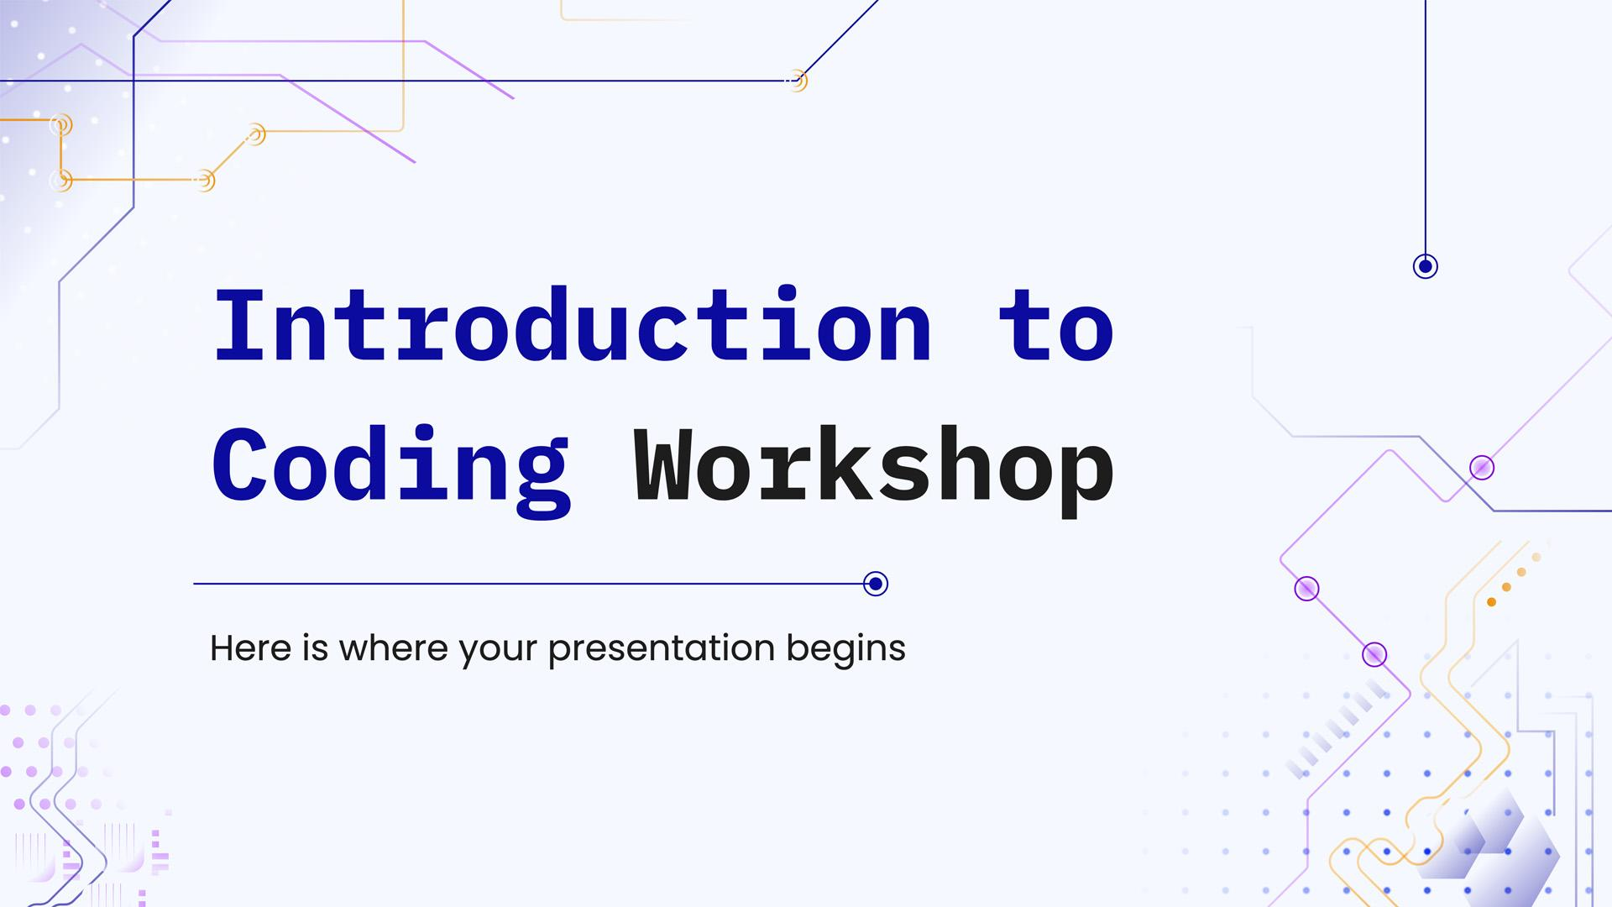
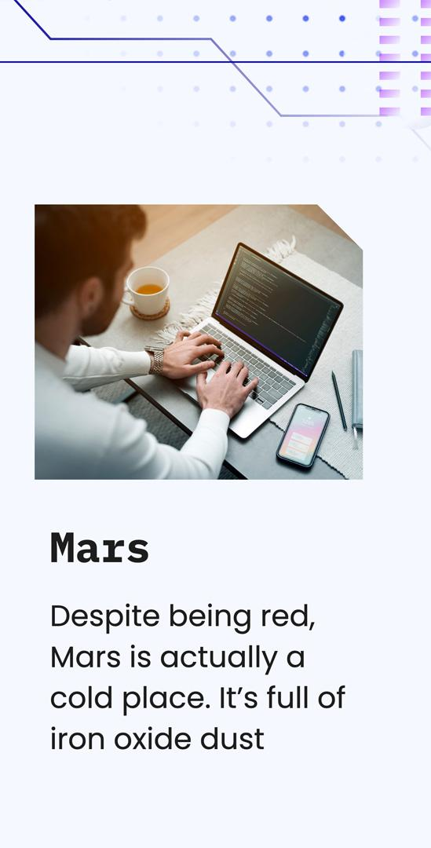
Mockups
You can replace the images on the screen with your own work. Just right-click on them and select “Replace image”

Slide 30
Thanks!
Do you have any questions?
youremail@freepik.com
+34 654 321 432
yourwebsite.com
Please keep this slide for attribution

Slide 31
Icon pack

Slide 32
Alternative resources
Here’s an assortment of alternative resources whose style fits that of this template:

Slide 33
Resources
Did you like the resources in this template? Get them for free at our other websites:
Photos:
Medium shot man working on laptop
Group of friends planning a trip in a cafe
Medium shot man working on laptop
Side view of men working on laptops at the office
Lifestyle of woman in the office
Secretary working on laptop
Vectors:
Abstract gradient circuit board background
Icon pack:
Icon Pack: Coding | Lineal

Slide 34
Instructions for use
If you have a free account, in order to use this template, you must credit Slidesgo by keeping the Thanks slide. Please refer to the next slide to read the instructions for premium users.
As a Free user, you are allowed to:
Modify this template.
Use it for both personal and commercial projects.
You are not allowed to:
Sublicense, sell or rent any of Slidesgo Content (or a modified version of Slidesgo Content).
Distribute Slidesgo Content unless it has been expressly authorized by Slidesgo.
Include Slidesgo Content in an online or offline database or file.
Offer Slidesgo templates (or modified versions of Slidesgo templates) for download.
Acquire the copyright of Slidesgo Content.
For more information about editing slides, please read our FAQs or visit our blog:
https://slidesgo.com/faqs and https://slidesgo.com/slidesgo-school

Slide 35
Instructions for use (premium users)
As a Premium user, you can use this template without attributing Slidesgo or keeping the Thanks slide.
You are allowed to:
Modify this template.
Use it for both personal and commercial purposes.
Hide or delete the “Thanks” slide and the mention to Slidesgo in the credits.
Share this template in an editable format with people who are not part of your team.
You are not allowed to:
Sublicense, sell or rent this Slidesgo Template (or a modified version of this Slidesgo Template).
Distribute this Slidesgo Template (or a modified version of this Slidesgo Template) or include it in a database or in any other product or service that offers downloadable images, icons or presentations that may be subject to distribution or resale.
Use any of the elements that are part of this Slidesgo Template in an isolated and separated way from this Template.
Register any of the elements that are part of this template as a trademark or logo, or register it as a work in an intellectual property registry or similar.
For more information about editing slides, please read our FAQs or visit our blog:
https://slidesgo.com/faqs and https://slidesgo.com/slidesgo-school

Slide 36
Fonts & colors used
This presentation has been made using the following fonts:
IBM Plex Mono Bold
(https://fonts.google.com/specimen/IBM+Plex+Mono)
Be Vietnam Pro Normal & Bold
(https://fonts.google.com/specimen/Be+Vietnam+Pro)
#f5f8ff
#bfbef7
#0c0a9e
#8208d5
#1d1d1d
#eb9109

Slide 37



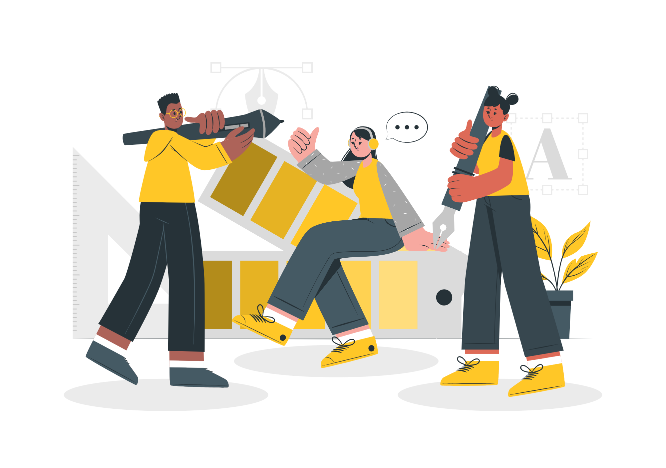

Storyset
Create your Story with our illustrated concepts. Choose the style you like the most, edit its colors, pick the background and layers you want to show and bring them to life with the animator panel! It will boost your presentation. Check out how it works.
Pana
Amico
Bro
Rafiki
Cuate

Slide 38
Use our editable graphic resources...
You can easily resize these resources without losing quality. To change the color, just ungroup the resource and click on the object you want to change. Then, click on the paint bucket and select the color you want. Group the resource again when you’re done. You can also look for more infographics on Slidesgo.

Slide 41
JANUARY
FEBRUARY
MARCH
APRIL
MAY
JUNE
PHASE 1
Task 1
Task 2
PHASE 2
Task 1
Task 2
JANUARY
FEBRUARY
MARCH
APRIL
PHASE 1
Task 1
Task 2

Slide 44
...and our sets of editable icons
You can resize these icons without losing quality.
You can change the stroke and fill color; just select the icon and click on the paint bucket/pen.
In Google Slides, you can also use Flaticon’s extension, allowing you to customize and add even more icons.

Slide 45
Educational Icons
Medical Icons

Slide 46
Business Icons
Teamwork Icons

Slide 47
Help & Support Icons
Avatar Icons

Slide 48
Creative Process Icons
Performing Arts Icons

Slide 49
Nature Icons

Slide 50
SEO & Marketing Icons

Slide 51


